Slide 1


Ph.D. Synopsis Seminar
on
Frequency Estimation under Stationary and Non-stationary Conditions - A Case Study of Induction Motor Fault Diagnosis
By
Anik Kumar Samanta
(16AT91R11)
Under the supervision of
Prof. Aurobinda Routray
&
Prof. Swanand R. Khare
Advanced Technology Development Centre
Indian Institute of Technology Kharagpur
January 2021

Slide 2
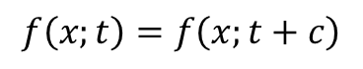
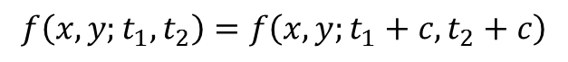
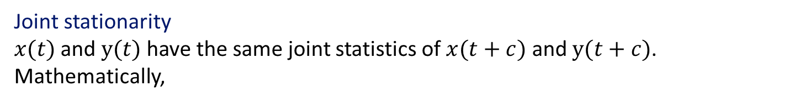
Stationarity
Stationary process
A stochastic process is said to be a stationary if it’s statistical properties are time-invariant. This is stationarity in strict sense. Mathematically,
$$f\left(x;t\right)=f\left(x;t+c\right)$$
Wide sense stationarity (WSS)
A stochastic process is WSS if it’s mean is constant and autocorrelation depends only on the delay. Mathematically,
$$E\left\{x\left(t\right)\right\}=η;and E\left\{x\left(t+τ\right)x^{∗}(t)\right\}=R(τ)$$
Joint stationarity
$x(t)$ and $y(t)$ have the same joint statistics of $x(t+c)$ and $y(t+c)$. Mathematically,
$$f\left(x,y;t_{1},t_{2}\right)=f\left(x,y;t_{1}+c,t_{2}+c\right)$$
“Majority of non-stationarities are due to temporally unstable variance and/or frequency”, Chau’05
2/36

Slide 3
Motivation and Objective
Detection of stationarity
Stationary segmentation
Parameter estimation under non-stationarity
Accuracy
Resolution
Noise Robustness
Execution Time
Spectral
Estimation
Assumption of stationarity
Instantaneous frequency estimation
Accuracy
Chirp rate
Abrupt changes
Noise Robustness
Fault detection of SCIMs*
Low amplitude
Variable frequency & load torques
Exact amplitude & decision rule
Objectives of the research
Detection and estimation of sinusoidal parameters under stationary as well as non-stationary conditions, and its application in diagnosing weak faults of SCIMs.
*SCIM: Squirrel Cage Induction Motor
3/36

Slide 4
Scope, Outline, and Overview of the Research
Frequency Estimation
Stationary
Non-stationary
Constrained Kalman Filter (P2)
Rayleigh Quotient (P1)
Bayesian
MAP (P6)
Estimate frequencies of multiple time-varying components simultaneously
Statistical evaluation
Gravitational waves for black hole merger
Statistical comparison
Noise Analysis
Resolution Analysis
Statistical comparison
Noise Analysis
Resolution Analysis
Minimum distance detector for inherent fault component (P5)
Detect SCIM faults from vibration (P4)
Implementation for IoT-based fault detector using stator current (P7)
Suppression of multiple dominant components (P3)
Hypothesis testing and automatic thresholding

Slide 5
Spectral Estimators – Review
Spectral Estimator
Classical
High Resolution
Limited Resolution
Parametric
Eigen-based [Hoang’17]
MUSIC
DFT
Classical
Bayesian [badiu’17]
ESPRIT
Periodogram
AR-spectrum
Gaussian
Modified-periodogram
ARMA-spectrum
Tikhonov
MA-spectrum
Bernoulli-Gaussian
Proposition 1: Rayleigh Quotient
Accurate frequency estimation
Noise robust
Accurate amplitude
MAP [Fu’07]
MMSE
Sparse-Bayes L1
ARMA – autoregressive moving average
MUSIC – Multiple signal classifier
ESPRIT – Est. of signal parameters via rotational invariance
MAP – Max. a-posterior estimate
MMSE – Minimum mean square error estimate
Proposition 2: Gauss-Markov Bayes MAP
Accurate frequency estimation
High resolution
Recursive

Slide 6
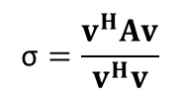
P1: Rayleigh-Quotient based Spectral Estimator
Development of spectral estimator
$$x\left[n\right]=\sum_{i=1}^{p}{\left.s_{i}e^{\left.j(ω_{i}n+φ_{i}\right)}+v[n\right]} \text{where}\text{, }n=0,1,...,N−1$$
and $v[n]$ is the additive noise
$$X_{β}=\left[\begin{matrix}x\left[0\right] & ⋅⋅⋅ & x\left[L−1\right] \\ ⋅ & ⋱ & ⋅ \\ x\left[L−1\right] & ⋅⋅⋅ & x\left[2L−2\right]\end{matrix}\right]$$
$${\hat{R}}_{x}=\frac{1}{L}X_{β}^{H}⋅X_{β}$$
and
If $A$ is a symmetric matrix with eigenvector $v$, there exist a corresponding eigenvalue σ, that can be approximated using the theory of Rayleigh quotients (Datta’10, Pg. 301-304) by
$$\text{σ}=\frac{v^{H}Av}{v^{H}v}$$
Presence of a sinusoid at $ω$will contribute to a peak (eigenvalue), given by $\hat{h}\left(ω\right)$, due to eigenvector $w\left(ω\right)$
$$w(ω)=\left[\begin{matrix}e^{−jω⋅0} & ⋯ & e^{\left.−jω(L−1\right)}\end{matrix}\right]$$
$$w(ω)w{\left(ω\right)}^{H}=L$$
Estimation of accurate amplitude
let us assume that the input signal consists of only a single component given by
AK Samanta, A Naha, A Routray, AK Deb, "Fast and accurate spectral estimation for online detection of partial broken bar in induction motors", Mechanical Systems and Signal Processing, 2018
6

Slide 7
Statistical Evaluation of the Spectral Estimator
Decision statistic:
$$γ(f_{1},f_{2})=h(f_{m})−\frac{1}{2}\left[\left.h(f_{1})+h(f_{2}\right)\right]<0$$
$$f_{m}=\frac{1}{2}\left(f_{1}+f_{2}\right)$$
;
$$f_{2}−f_{1}=\text{1 }\text{Hz}$$
Fs = 1000Hz
L = 1000
A
B
C
Fs = 1000Hz
Fig. 1 Probability of resolution for (A) Autocorrelation matrix size (B) SNR level (C) Sampling frequency
System Specification:
Processor: Intel Xeon 2.80 GHz
RAM: 16 GB
OS: Windows 7 (Professional)
Fig. 2 Propagation of frequency estimate error with (D) SNR level (E) Autocorrelation matrix size
Fig. 3 Mean Execution time over 100 runs for each autocorrelation matrix size

Slide 8
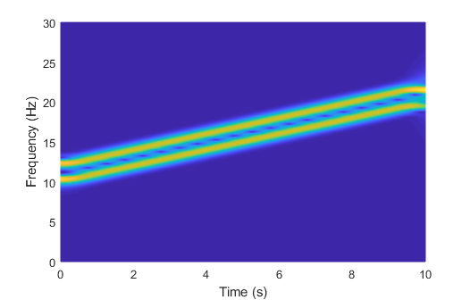
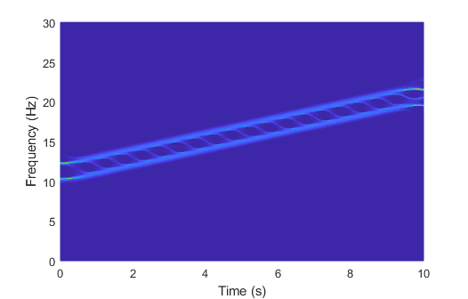
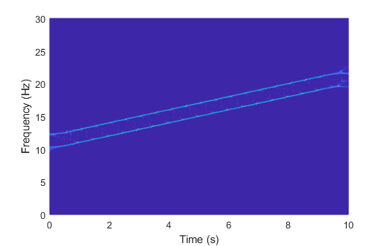
Instantaneous Frequency Estimation - Review
1970
1980
Late 1980
1990
STFT
Wavelet
Spectrogram
Scalogram
Wigner Distribution
Use of phase
Synchro-squeeze (SST) [Oberlin’15]
Reassignment [Auger’13]
Limited resolution
Cross term for multiple components
Limited resolution
Indirect method
Window selection not based on chirp-rate, resolution.

Slide 9
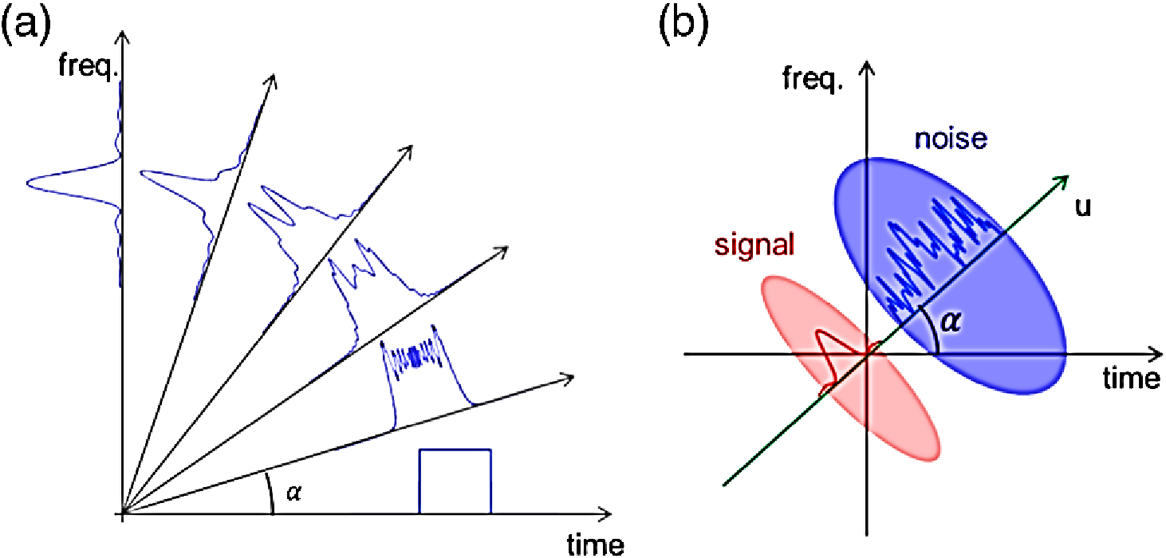
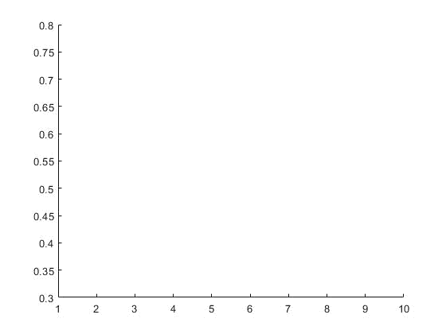
Instantaneous Frequency Estimation - Review
Late 1990s
Late 2000
Present
S-transform
Fractional Fourier Transform
Empirical Mode Decom.
Kalman Filters [Routray’02]
Modified SST
Variational Mode Decom.
*
Kalman Filter
High resolution, but error prone
Frequency (Hz)
Proposed Method
Pros:
High-resolution
Multiple time-varying components
Provision for model (more accurate)
Handle abrupt changes
Cons:
Parameter initialization
Low-SNR accuracy
Window selection based on chirp-rate, resolution for single component
Time (s)
Recursive, single Component Estimation
Physical significance of mode is complex
*Image source: “Agile photonic fractional Fourier transformation of optical and RF signals”, Optica 4.8 (2017): 907-910.

Slide 10

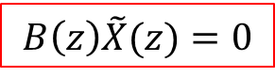
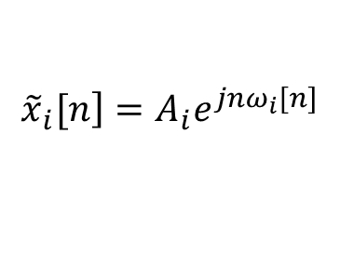
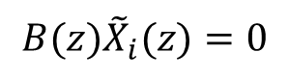
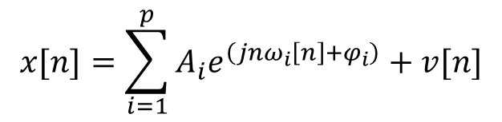
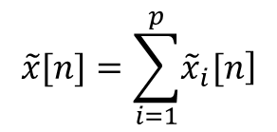
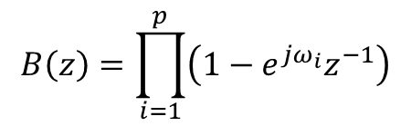
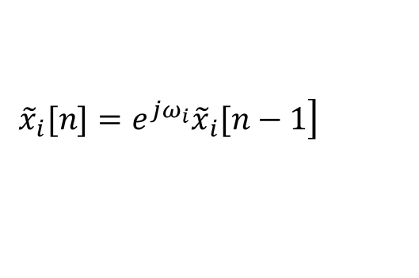
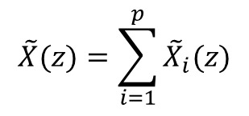

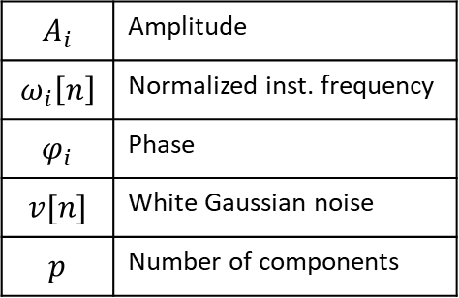
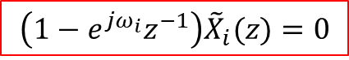
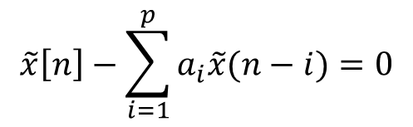
P2: Real-time Estimation of Multiple Time-varying Frequency Components
Signal Model
$$A_{i}$$ | Amplitude
$$ω_{i}\left[n\right]$$ | Normalized inst. frequency
$$φ_{i}$$ | Phase
$$v[n]$$ | White Gaussian noise
$$p$$ | Number of components
$$x[n]=\sum_{i=1}^{p}{A_{i}e^{\left(jnω_{i}\left[n\right]+φ_{i}\right)}}+v[n]$$
$$\tilde{x}[n]=\sum_{i=1}^{p}{\left.{\tilde{x}}_{i}[n\right]}$$
$$\tilde{X}(z)=\sum_{i=1}^{p}{{\tilde{X}}_{i}(z)}$$
$${\left.{\tilde{x}}_{i}[n\right]=A}_{i}e^{j{nω}_{i}[n]}$$
Represent $\left.{\tilde{x}}_{i}[n\right]$ as an AR process by assuming a frozen state with constant coefficients for short duration for slowly-varying signals [9] as
$$\left.{\tilde{x}}_{i}[n]=e^{jω_{i}}{\tilde{x}}_{i}[n−1\right]$$
Taking z-transform, we have:
$$\left(1−e^{jω_{i}}z^{−1}\right){\tilde{X}}_{i}(z)=0$$
$$B\left(z\right)=\prod_{i=1}^{p}{\left(1−e^{jω_{i}}z^{−1}\right)}$$
For$p$-components:
Inverse z-transform:
Therefore,
$$B(z){\tilde{X}}_{i}(z)=0$$
$$\tilde{x}\left[n\right]−\sum_{i=1}^{p}{a_{i}\tilde{x}(n−i)=0}$$
Hence,
$$B\left(z\right)\tilde{X}(z)=0$$
AK Samanta, A Routray, SR Khare, A Naha, "Direct estimation of multiple time-varying frequencies of non-stationary signals", Signal Processing, 169, 107384, 2020.

Slide 11
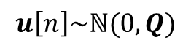
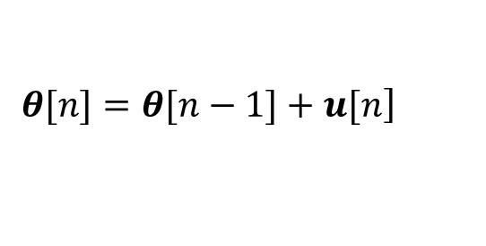
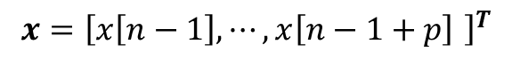
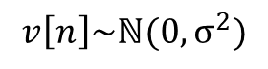
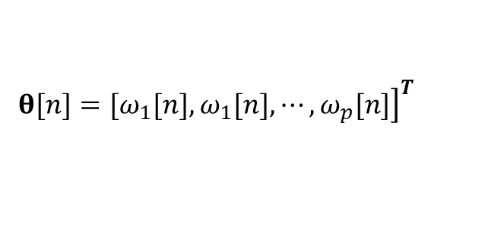
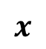
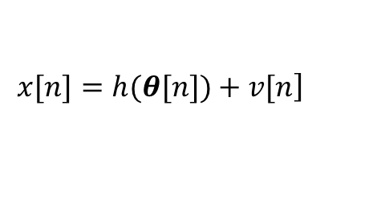
Observation and State Models
Observation Model:
$$\left.x[n]=h(θ[n])+v[n\right]$$
$$v\left[n\right]\sim ℕ(0,σ^{2})$$
$$x$$
States:
$$x={\left[x\left[n−1\right],⋯,x\left[n−1+p\right] \right]}^{T}$$
$${\left.θ[n]=[ω_{1}[n],ω_{1}[n],⋯,ω_{p}[n]\right]}^{T}$$
State Propagation – Gauss-Markov Random Walk:
$$\left.θ[n]=θ[n−1]+u[n\right]$$
$$u\left[n\right]\sim ℕ(0,Q)$$
Linearization with Taylor expansion:
$h(θ[n])=h(\hat{θ}[n|n−1])$ $+{\frac{\left.∂h(θ[n]\right)}{\left.∂(θ[n]\right)}|}_{\left.θ[n]=\hat{θ}[n|n−1\right]}\left(\left.θ[n]−\hat{θ}[n|n−1\right]\right)$

Slide 12
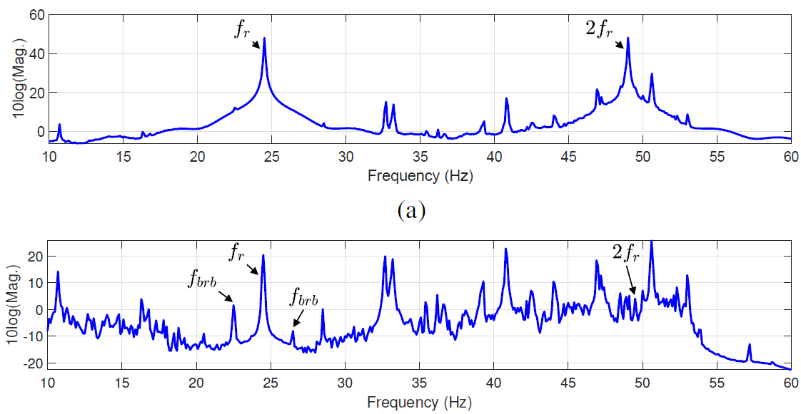
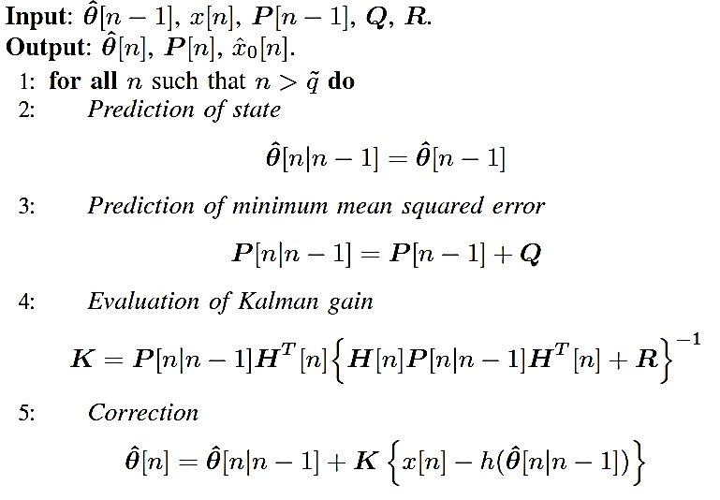
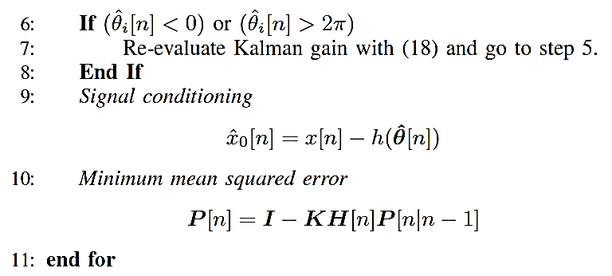
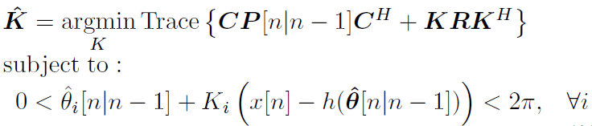
P3: Real-time Estimation and Elimination of Multiple Dominant Components
Algorithm: Elimination of dominant frequencies
(b)
Fig. 1 Spectrum analysis of motor vibration (a) before and (b) after signal conditioning.
AK Samanta, A Routray, SR Khare, & A Naha, “Minimum Distance-based Detection of Incipient Induction Motor Faults using Rayleigh Quotient Spectrum of Conditioned Vibration Signal”, in IEEE Transactions on Instrumentation and Measurement , 2021.

Slide 13
IF Estimation – Simulated Results
Fig. 1 Distant frequency estimation
Fig. 2 Closely spaced frequency estimation
SNR = 40 dB
Fs = 200 Hz
Key observation:
Frequency estimates don’t cross
Fig. 3 Estimation of cross-over frequencies

Slide 14
IF Estimation – Statistical Results
A
B
Fig. 1 NMSE for frequency estimation at different (A) SNR levels and (B) Chirprate
with 1000 Monte-Carlo simulations.
Fig. 2 NMSE versus variation of frequency difference with 1000 Monte-Carlo simulation (SNR = 60 dB).
Fig. 3 Abrupt change in a frequency component
Fig. 4 Accuracy of frequency estimate with abrupt change

Slide 15
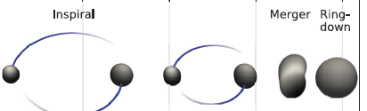
Real-world Examples: Bat-signal and GW-wave Analysis
Fig. 1 Time-frequency analysis of the popular ’Batsignal’, an echolocation
pulse emitted by a big brown bat
Key observation:
Three components detected and estimated
Fig. 2 Frequency estimation for the binary black-hole collision event GW150914 observed at Hanford, Washington (H1)
Key observation:
Smoother estimate of different phases

Slide 16
Real-world Examples: Supply Frequency Estimation
Fig. 1 Estimation of abrupt change in fundamental supply frequency using stator current of a squirrel cage induction motor. The temporal resolution during the initial stages of the abrupt change is depicted in the inset in log-scale.
Key observations:
Fast response
Drive dynamics captured

Slide 17
State of the Art for IM Fault Diagnosis
Induction motor weak faults
Signatures used
[Riera-Guasp’15]
Stator faults
Rotor faults
Bearing faults
Inner Raceway
Acoustic
Vibration
Stator Current
Magnetic Field
Supply Voltage
Active-Reactive Power
Thermal Field
Thermal Imaging [Prieto’18]
Inter-turn
short circuit
Broken rotor bar
Outer Raceway
Broken End Ring
Cage fault
Eccentricity
Rolling element
Cause
Symptoms
Fatigue
Inherent eccentricity
Flaking and spalling due to small metal parts
Manufacturing defects
Contamination and abrasion
Bearing current
Improper lubrication
Technology
Vibration
Modulated stator currents
Torque pulsation and reduced average torque
Rotor speed pulsation and low average speed
Excessive heating
Power Spectral Density (PSD)
Multiple Signal Classification (MUSIC) [Nandi’05, Naha’16]
ESPRIT
Wavelet Decomposition
Synchrosqueeze [Tu’19]
Pattern Recog [Panderkone’19]
Deep learning [Zhao’19]
Notes:
1. Esprit: estimation of signal parameters via rotational invariance techniques
2. Why stator current and why MUSIC??

Slide 18
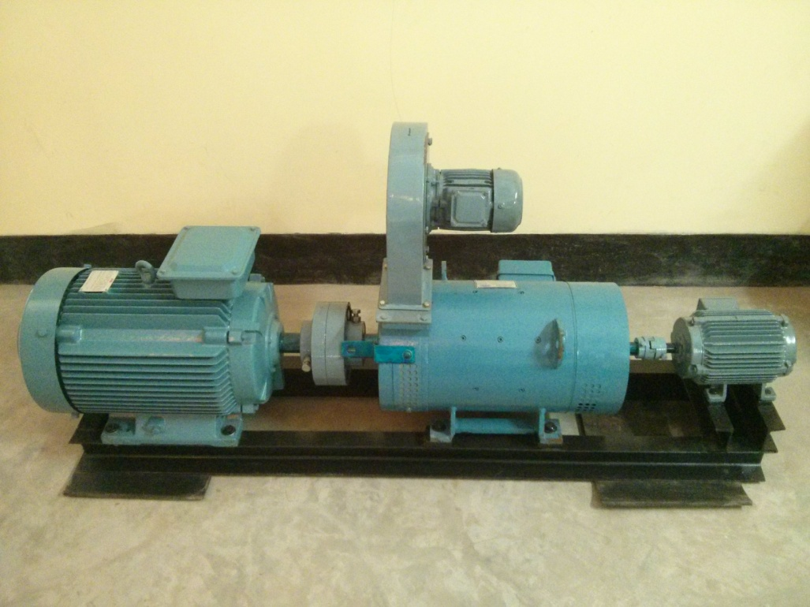
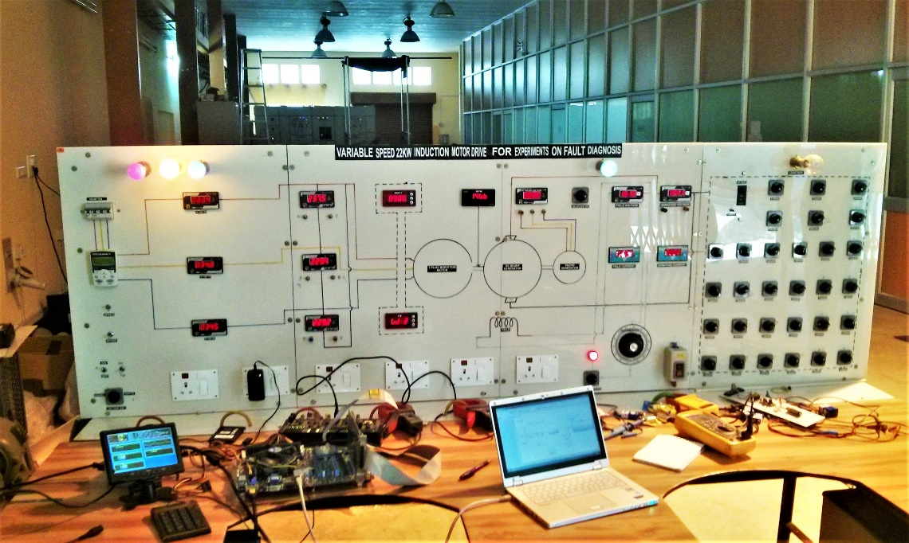
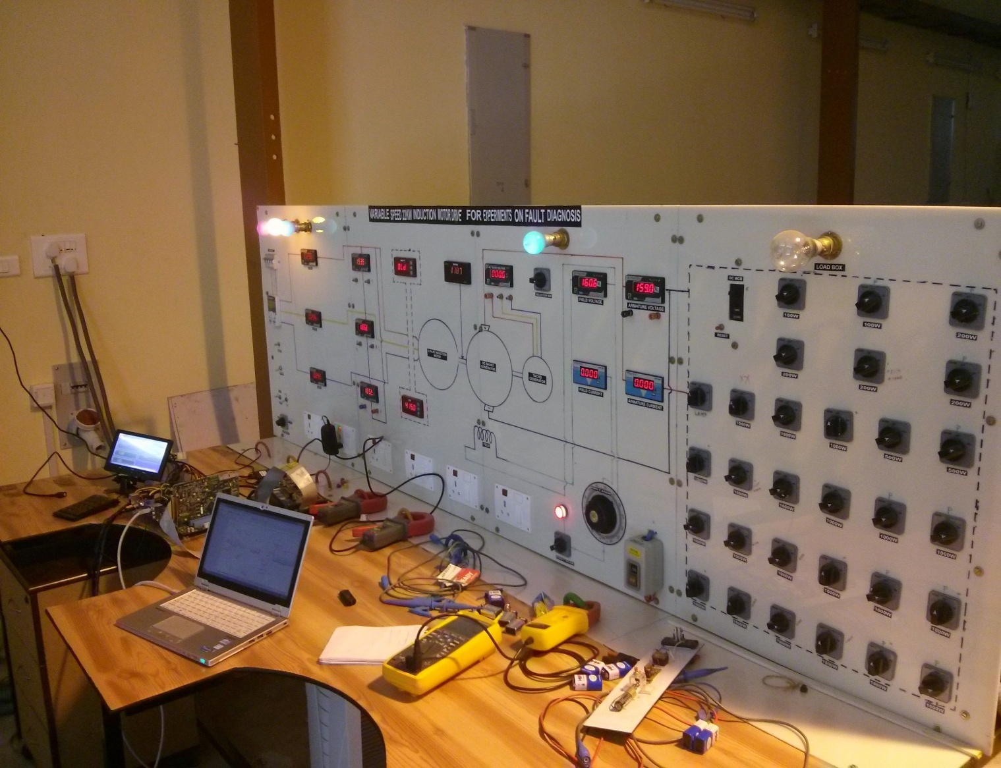
Experimental Setup (22kW IM-24kW DC Gen)
For generating various base and fault signatures, testing and validation of algorithms in lab
Cooling Arrangement
IM V/F control
DC generator control and indicating instruments
AC Tacho Generator
Induction Motor
IM indicating instruments
Load switches
DC Generator
Vibration sensor location
(A) Induction Motor - DC Generator Set
(B) Panel Board
Specification of the Experimental Setup
Rated voltage | 415V
Rated current | 40.5A
Number of poles | 4
Rated power | 22kW
Number of phases | 3
Number of rotor bars | 28
Target
Sensor
Host
(C) Sensor-Target Interface

Slide 19
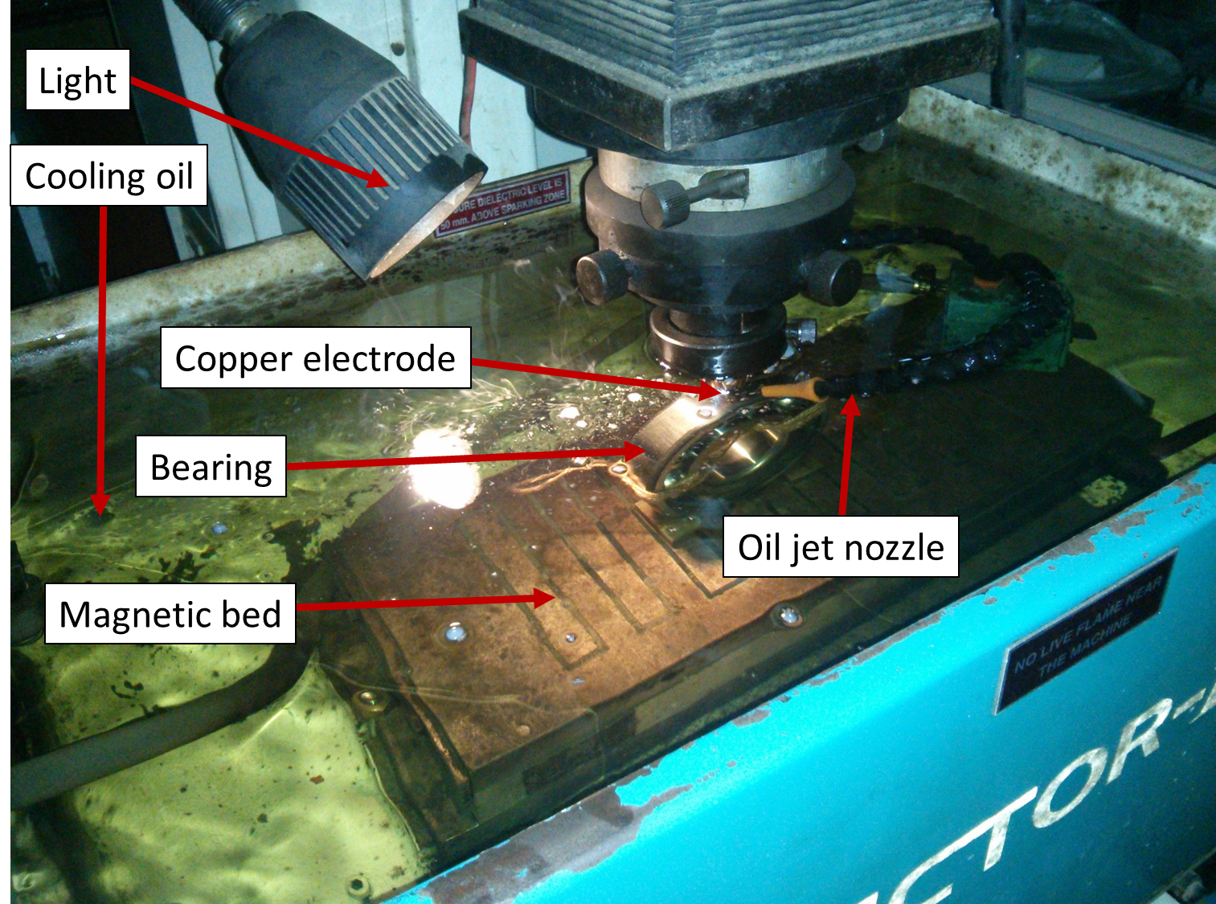
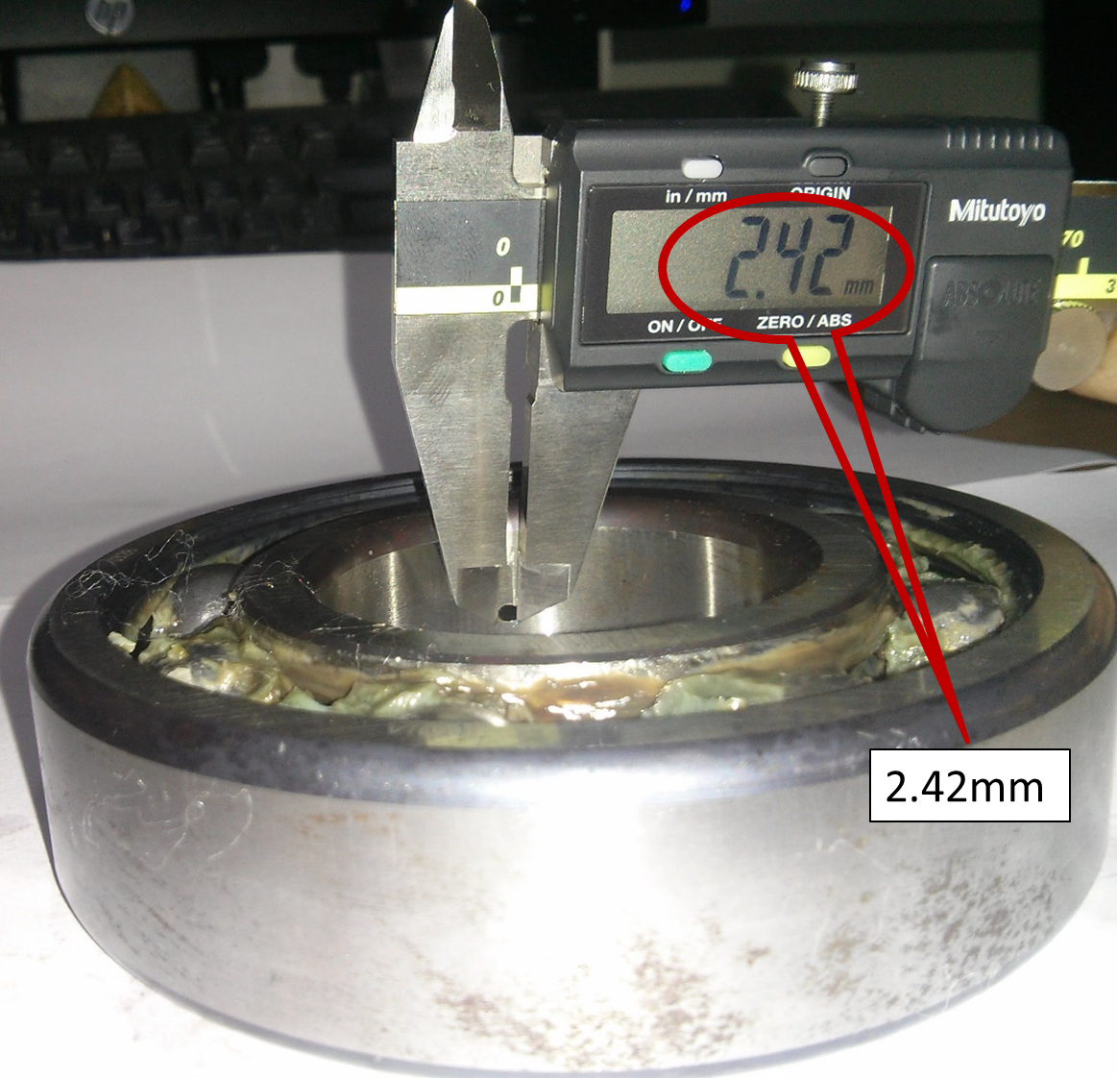
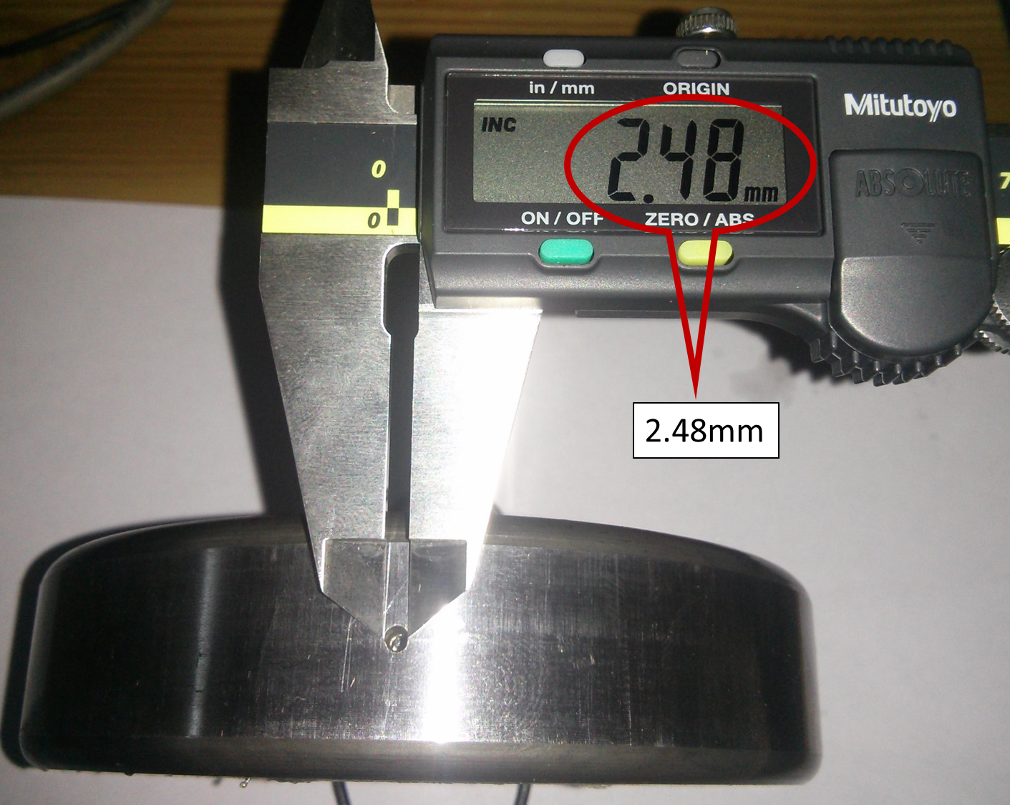
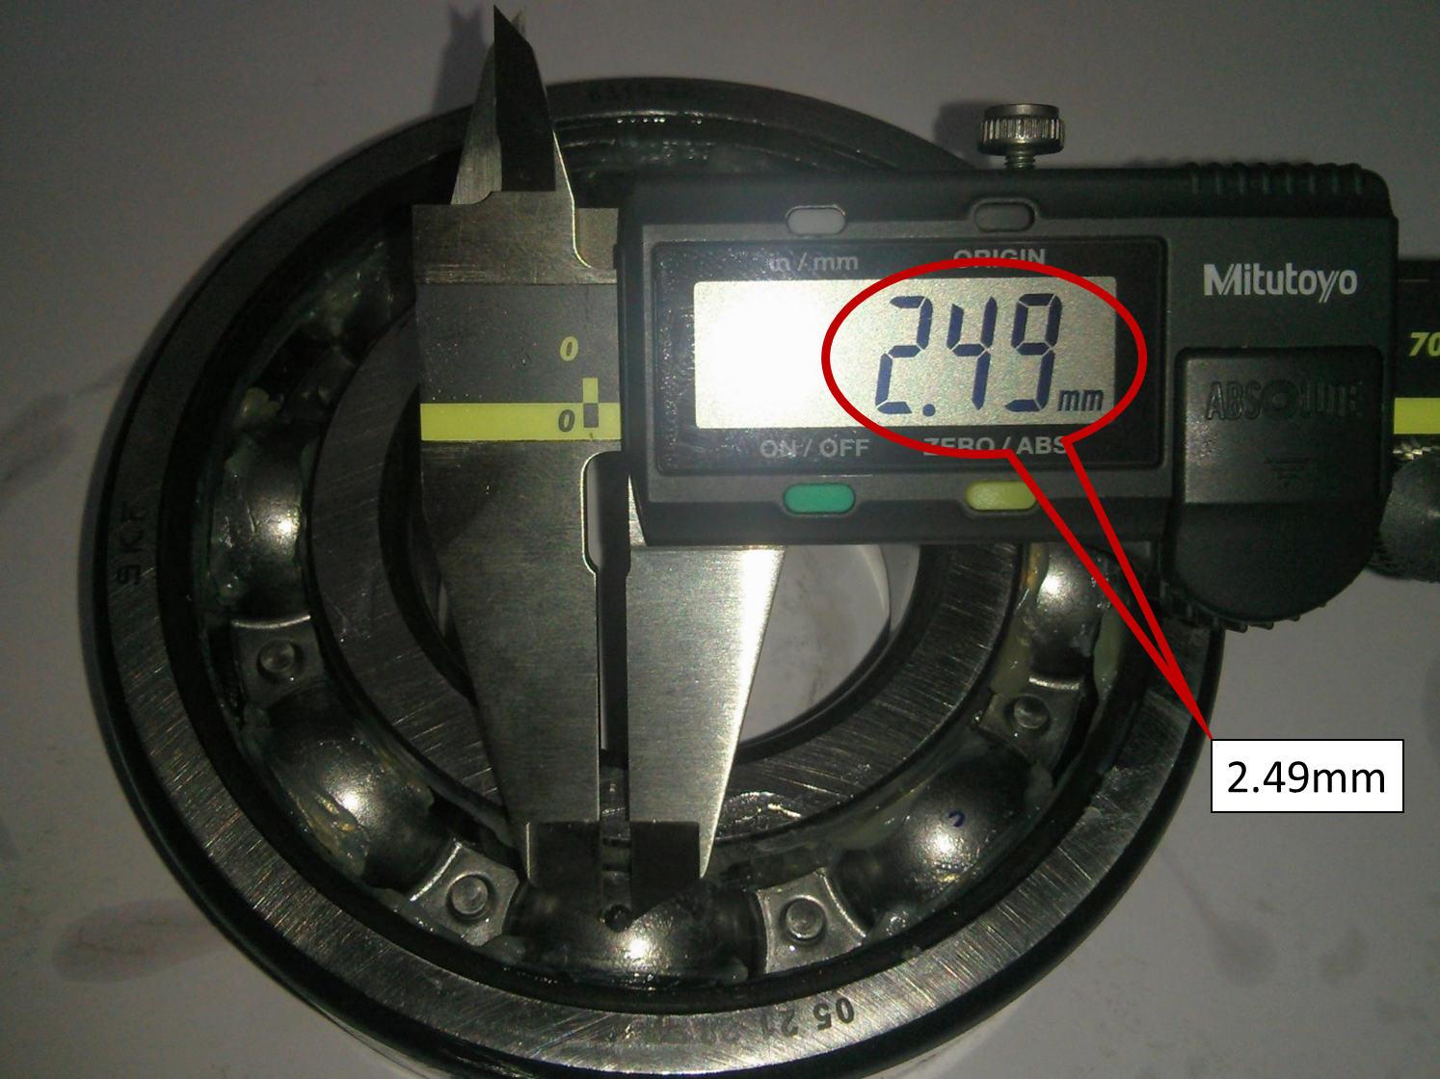
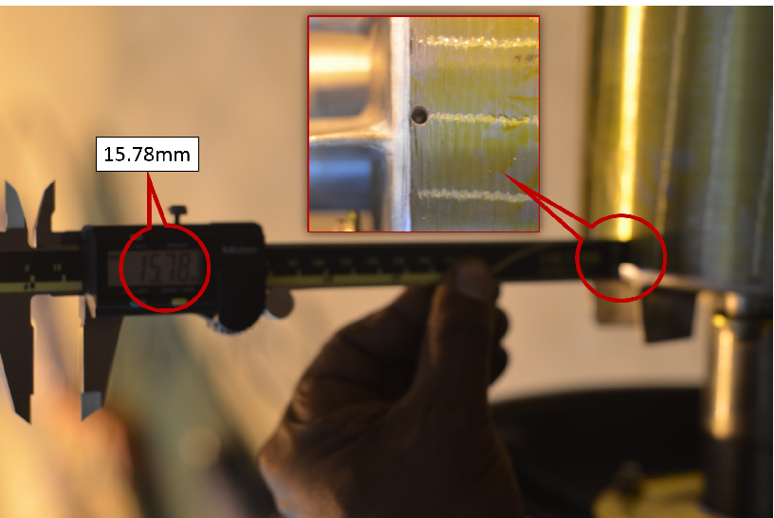
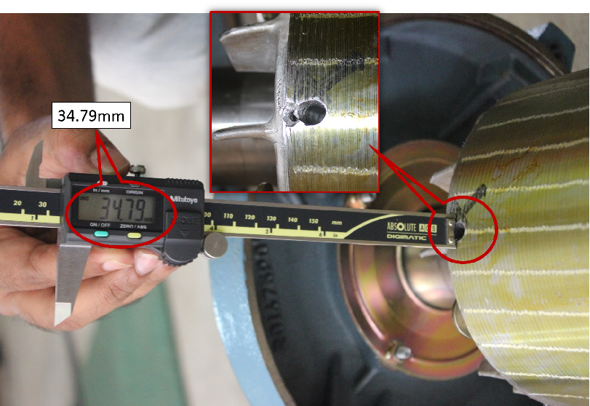
Introducing Faults
Fig. 1 Spark electric discharge
machining
Fig. 2 Inner Raceway Fault
Fig. 3 Outer Raceway Fault
Fig. 4 Rolling Element Fault
Fig. 5 Half broken rotor bar
Fig. 6 Full broken rotor bar

Slide 20
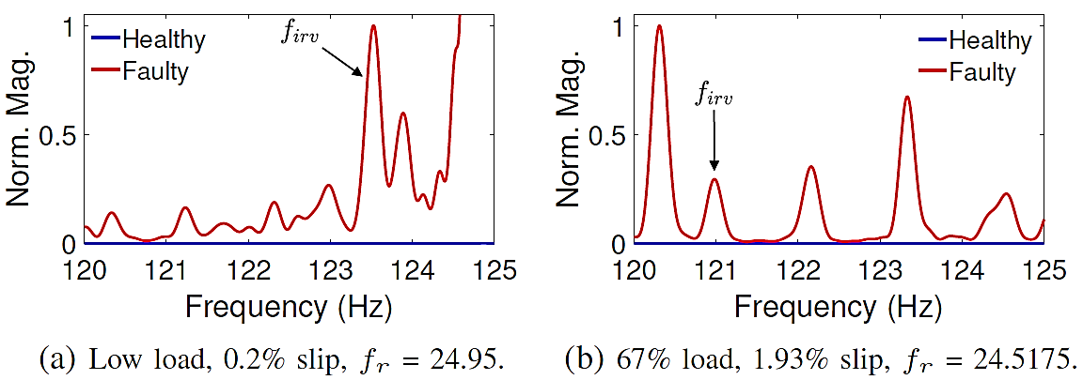
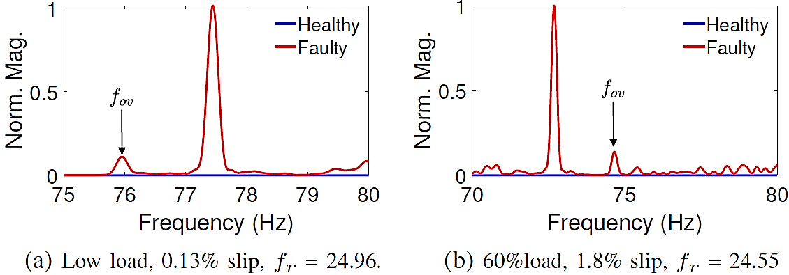
P4: Vibration Analysis with Rayleigh Quotient
Key observations:
Prominent fault component
Matches theory
Fig. 1 Spectrum of the conditioned vibration signal obtained from the lab-setup, with inner-race fault for different load levels.
Key observations:
Prominent fault component
Matches theory
Fig. 2 Spectrum of the conditioned vibration signal obtained from the lab-setup, with outer-race fault for different load levels.

Slide 21
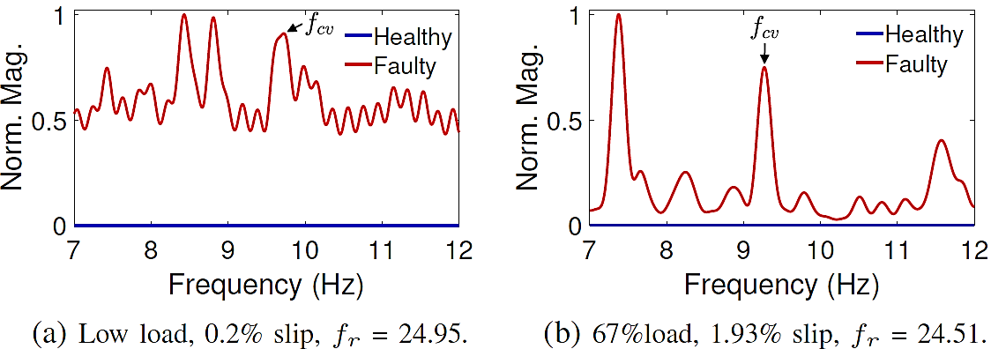
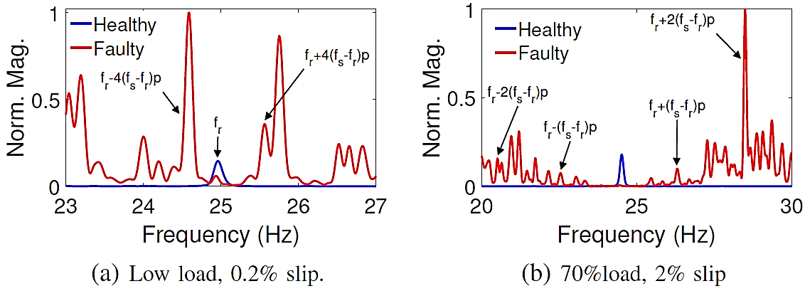
Vibration Analysis with Rayleigh Quotient
Key observations:
Inadvertent fault
High-load prominence
Matches theory
Fig. 1 Spectrum of the conditioned vibration signal obtained from the lab-setup, with cage fault for different load levels.
Key observations:
Signal conditioning improves detection
Matches theory
Fig. 2 Spectrum of the conditioned vibration signal obtained from the lab-setup, with broken rotor bar fault for different load levels.

Slide 22
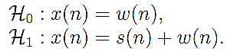
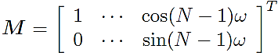
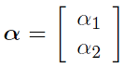
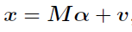
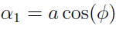






P5: Minimum Distance-based Detection
Conventional:
Our proposition:
$$ℋ_{0}: x\left(n\right)=𝒶\cos\left(ωn+φ\right)+v\left(n\right); 𝒶<γ$$
$$ℋ_{1}: x\left(n\right)=𝒶\cos\left(ωn+φ\right)+v\left(n\right); 𝒶≥γ$$
The linear model:
Probability density function:
Parameter Estimates under each Hypothesis:
AK Samanta, A Routray, SR Khare, & A Naha, “Minimum Distance-based Detection of Incipient Induction Motor Faults using Rayleigh Quotient Spectrum of Conditioned Vibration Signal”, in IEEE Transactions on Instrumentation and Measurement , 2021.

Slide 23












Implementation, Simulation and Practical Results
Input
Pre-processing
Spectral Estimation
Peak Detection
$$ω$$
$$is$$
$$T_{1}>T_{0}$$
Simulation Results:
$$N$$
$$Y$$
Healthy
Faulty
Simulation parameter
$$ω∈𝒰\left(0.01π,0.5π\right)$$
$$φ∈𝒰(0,π)$$
$$p\left(𝒶 | ℋ_{0}\right)\sim 𝒰(0,γ−τ)$$
$$p\left(𝒶 | ℋ_{1}\right)\sim 𝒰\left(γ+τ,10\right)$$
$γ$=5
Fault Detection
Accuracy:
Fault type | Accuracy (%)
 | Lab Data | CWRU Data
Broken rotor bar | 95.09 % | Not available
Rolling Element | 98.44 % | 100 %
Cage defect | 98.36 % | 100 %
Inner Raceway | 90.33 % | 100 %
Outer raceway fault | 96.77 % | 100 %
$$γ−τ$$
$$γ$$
$$γ+τ$$
$p_{e}=p\left(ℋ_{1} | ℋ_{0}\right)p(ℋ_{0})$+
$$p\left(ℋ_{0} | ℋ_{1}\right)p(ℋ_{1})$$
$$p\left(ℋ_{1}\right)=p\left(ℋ_{0}\right)=0.5$$

Slide 24









P6: Bayesian MAP Sequential Spectral Estimation
Signal Model
$$x(n)=\sum_{i=1}^{k}{\left.A_{i}cos(nω_{i}+φ_{i}\right)},$$
$$A_{i}$$ | Amplitude
$$ω_{i}$$ | Normalized instantaneous frequency
$$φ_{i}$$ | Phase
$$v(n)$$ | White Gaussian noise (observation)
$$p$$ | Number of components
$$x\left(n\right)=\sum_{i=1}^{p}{\left.a_{i}(n)x(n−i\right)}+v(n)$$
$$\left.x(n)=a^{T}(n)x(n−1)+v(n\right)$$
$$a(n)={\left[\begin{matrix}\left.a_{1}(n\right) & \left.a_{2}(n\right) & ⋯ & \left.a_{p}(n\right)\end{matrix}\right]}^{T}$$
$$\left.a(n)=a(n−1)+u(n\right)$$
$$x(n)={\left[\begin{matrix}\left.x(n\right) & \left.x(n−1\right) & ⋯ & \left.x(n−p+1\right)\end{matrix}\right]}^{T}$$
$$u\left(n\right)\sim ℕ(0, σ_{u}^{2})$$
$$p\left(\left.a(n\right)\right)=k_{2}exp\left\{−\frac{1}{2σ_{u}^{2}}{\left[\left.a(n)−a(n−1\right)\right]}^{T}\left[\left.a(n)−a(n−1\right)\right]\right\}$$
Likelihood:
Prior PDF:

Slide 25

Maximum a Posteriori Estimate
Posterior PDF:
Find:
Solution:
Power Spectrum
Recursive estimation of associated parameters:

Slide 26



Algorithm Implementation and Key Observations
Low Order = 10
Normalized Power
High Order = 100
Some observations
1. The lobe-width is high with low orders
2. With low-order, the accuracy increases with increase in observations.
3. Multiple peaks appear with increased order
4. The spurious peaks disappear with increased observation
5. Lobe-width decreases, Resolution improves
Normalized Power
Frequency (Hz)

Slide 27
Statistical Results
Fig. 1 Spectral estimation with different methods. N = 100, f1 = 50Hz, and SNR = 3 dB.
Fig. 2 Mean squared error variation with data length. SNR = 6.98 dB
Fig. 3 Mean squared error variation with the signal to noise ratio. N = 1000
Fig. 4 Variation of the probability of resolution of two sinusoidal components with different model-order.

Slide 28
Results-SCIM Fault Diagnosis
A
C
D
B
Fig. 1 BRB Fault (A) Low Load (B) High Load
Fig. 2 Cage Fault (C) Low Load (D) High Load

Slide 29
Results-SCIM Fault Diagnosis
A
C
B
D
Fig. 1 Inner-raceway (A) Low Load (B) High Load
Fig. 2 Outer-raceway (C) Low Load (D) High Load

Slide 30





Progression of Fault Diagnosis Systems
Fig. 1 The online fault detection system and its console system
Fig. 2 Raspberry pi implementation
Fig. 5 Cloud-based implementation with in-house WiFi current sensors
Fig. 3 The offline fault analyzer
Fig. 4 Mobile phone based fault detector
SCIM fault model developed with nine faults with real-time simulation
Methods developed to detect SCIM faults in transient and steady state conditions
A low complexity method developed for continuous online condition monitoring
A mobile application developed for SCIM health assessment in the absence of dedicated hardware and processing platforms

Slide 31






P7: IoT-based Fault Detection System
Server
Client: User
IOT-based hardware framework used for fault detection
Implementation of the algorithm

Slide 32
Conclusions
Frequency Estimation
Stationary
Non-stationary
Rayleigh Quotient
Bayesian
MAP
Constrained Kalman Filter
Pros:
Fast and accurate frequency estimation
Noise-robust
Accurate amplitude estimation
Analyzed bearing faults using vibration
High-resolution, recursive, and accurate frequency estimation
Analyzed SCIM faults stator current
Implemented for IoT-based fault detection unit
Accurate frequency estimation of multiple time varying components
High resolution
Recursive
Can handle abrupt changes in frequency
Suppression of multiple dominant components (SCIM signal conditioning)
Cons:
Low resolution
Amplitude estimation is required
Performance under low-SNR to be improved

Slide 33
Organization of the Thesis
Chapter 1: Introduction
Chapter 2: Direct Estimation of Multiple Time-varying Frequencies of Non-stationary Signals
Proposes a generalized framework for real-time tracking of multiple time-varying sinusoidal frequencies of a non-stationary signal.
Chapter 3: Rayleigh Quotient Spectrum for Online Detection of Partial BRB in SCIM
Introduces the Rayleigh-quotient-based spectral estimator and uses it for detecting partially broken rotor bar faults using stator current. It also describes the SCIM experimental setup
Chapter 4: Minimum Distanced Fault Detector using Rayleigh Quotient Vibration Spectrum
Extends the IF-estimator to eliminate multiple dominant components. Uses minimum distance-based hypothesis test for fault detection. Detects multiple SCIM faults using Rayleigh-quotient spectrum of vibration
Chapter 5: Bayes Maximum a-Posterior Spectral Estimation for Stator Current Analysis
Proposed a Bayesian MAP-based sequential spectral estimator for detecting SCIM faults using a single-phase stator current input.
Chapter 6: Embedded Fault Detection System Development
Chapter 7: Conclusions and Future Research Directions

Slide 34
Publications from the Thesis
Patent (Filed):
A. Routray, A. Naha, AK Samanta, Amey Pawar, Chandrasekhar Sakpal, “A system for assessment of multiple faults in induction motors”, WO2019167086A1, 2019
Journals:
AK Samanta, A Routray, SR Khare, & A Naha, “Minimum Distance-based Detection of Incipient Induction Motor Faults using Rayleigh Quotient Spectrum of Conditioned Vibration Signal [Accepted]”, in IEEE Transactions on Instrumentation and Measurement
AK Samanta, A Routray, SR Khare, A Naha, "Direct estimation of multiple time-varying frequencies of non-stationary signals", Signal Processing, 169, 107384, 2020.
AK Samanta, A Naha, A Routray, AK Deb, "Fast and accurate spectral estimation for online detection of partial broken bar in induction motors", Mechanical Systems and Signal Processing, 2018
Journal under preparation:
Sequential Maximum a-Posterior Spectral Estimation for IoT-based Fault Detection of Squirrel
Cage Induction Motors

Slide 35
Bibliography
Spectral Estimation
[Badiu’17] M.-A. Badiu, T. L. Hansen, and B. H. Fleury, ”Variational Bayesian inference of line spectra," IEEE Trans. Signal Process., vol. 65, no. 9, pp. 2247-2261, 2017.
[Datta’10] B. N. Datta, Numerical linear algebra and applications. Siam, 2010.
[Djuric’95] P. M. Djuric and H.-T. Li, “Bayesian spectrum estimation of harmonic signals," IEEE Signal Process. Lett., vol. 2, no. 11, pp. 213-215, 1995.
[Hoang’18] M. Trinh-Hoang, M. Viberg, and M. Pesavento, “Partial relaxation approach: An eigenvalue-based DOA estimator framework,” IEEE Trans. Signal Process., vol. 66, no. 23, pp. 6190–6203, 2018.
[Hu’08] H. Fu and P. Y. Kam, ”MAP/ML estimation of the frequency and phase of a single sinusoid in noise," IEEE Trans. Signal Process., vol. 55, no. 3, pp. 834-845, 2007.
[Tenneti’19] S. V. Tenneti and P. P. Vaidyanathan, “imusic: A family of music-like algorithms for integer period estimation,” IEEE Trans. on Signal Process., vol. 67, no. 2, pp. 367–382, 2019.
Instantaneous Frequency Estimation
[Auger’13] F. Auger, P. Flandrin, Y.-T. Lin, S. McLaughlin, S. Meignen, T. Oberlin, and H.-T. Wu, “Time-frequency reassignment and synchrosqueezing: An overview," IEEE Signal Process. Mag., vol. 30, no. 6, pp. 32-41, 2013.
[Chen’10] C. Chen, G. Chang, R. Hong, and H. Li, “Extended real model of Kalman filter for time-varying harmonics estimation,” IEEE Trans. Power Del., vol. 25, no. 1, pp. 17-26, 2010.
[Hlawatsch’13] F. Hlawatsch and F. Auger, Time-frequency analysis. John Wiley & Sons, 2013.
[Jensen’17] T. L. Jensen, J. K. Nielsen, J. R. Jensen, M. G. Christensen, and S. H. Jensen, “A fast algorithm for maximum-likelihood estimation of harmonic chirp parameters," IEEE Trans. Signal Process., vol. 65, no. 19, pp. 5137-5152, 2017.
[Oberlin’15] T. Oberlin, S. Meignen, and V. Perrier, “Second-order synchrosqueezing transform or invertible reassignment? towards ideal time-frequency representations." IEEE Trans. Signal Process., vol. 63, no. 5, pp. 1335-1344, 2015.
[Routray’02] Routray, A., Pradhan, A. K., & Rao, K. P. (2002). A novel Kalman filter for frequency estimation of distorted signals in power systems. IEEE Transactions on Instrumentation and Measurement, 51(3), 469-479.

Slide 36
Bibliography
Fault Detection
[Dalvand’18] F. Dalvand, M. Kang, S. Dalvand, and M. Pecht, “Detection of generalized-roughness and single-point bearing faults using linear prediction-based current noise cancellation," IEEE Trans. Ind. Electron, vol. 65, no. 12, pp. 9728-9738, 2018.
[Delgado-Prieto’18] M. Delgado-Prieto, J. A. Carino-Corrales, J. J. Saucedo-Dorantes, R. de Jesus Romero-Troncoso, and R. A. Osornio-Rios, “Thermography-based methodology for multifault diagnosis on kinematic chain,” IEEE Trans. Ind. Inform., vol. 14, no. 12, pp. 5553-5562, 2018.
[Nandi’05] S. Nandi, H. A. Toliyat, and X. Li, “Condition Monitoring and Fault Diagnosis of Electrical Motors A Review," IEEE Trans. Energy Convers., vol. 20, no. 4, pp. 719-729, 2005
[Riera-Guasp’15] M. Riera-Guasp, J. A. Antonino-Daviu, and G.-A. Capolino, “Advances in Electrical Machine, Power Electronic, and Drive Condition Monitoring and Fault Detection: State of the Art," IEEE Trans. Ind. Electron., vol. 62, no. 3, pp. 1746-1759, 2015.
[Tu’19] X. Tu, Y. Hu, F. Li, S. Abbas, Z. Liu, and W. Bao, “Demodulated high-order synchro-squeezing transform with application to machine fault diagnosis,” IEEE Trans. Ind. Electron, vol. 66, no. 4, pp. 3071-3081, 2019.
[Zhao’19] R. Zhao, R. Yan, Z. Chen, K. Mao, P. Wang, and R. X. Gao, “Deep learning and its applications to machine health monitoring,“ Mech. Syst. Signal Process., vol. 115, pp. 213-237, 2019.
Non-Stationarity Detection
[Borgnat’10] P. Borgnat, P. Flandrin, P. Honeine, C. Richard, and J. Xiao, “Testing stationarity with surrogates: A time-frequency approach” IEEE Trans on Sig. Process, vol. 58, no. 7, pp. 3459–3470, 2010.
[Chau’05] T. Chau, D. Chau, M. Casas, G. Berall, and D. J. Kenny, “Investigating the stationarity of paediatric aspiration signals,” IEEE Trans. Neural Sys. and Rehabilitation Engg., vol. 13, no. 1, pp. 99–105, 2005.
[Chu’17] Y. Chu and C. M. Mak, “A new parametric adaptive nonstationarity detector and application," IEEE Trans. Signal Process. vol. 65, no. 19, pp. 5203-5214, 2017.
[Kay’08] S. Kay, “A new nonstationarity detector,” IEEE Trans on Sig. Process., vol. 56, no. 4, pp. 1440–1451, 2008.
[Rudoy’11] D. Rudoy, T. F. Quatieri, and P. J. Wolfe, “Time-varying Autoregressions in Speech: Detection Theory and Applications,"
IEEE Trans. Acoust., Speech, Signal Process., vol. 19, no. 4, pp. 977-989, 2011.
[Sanei’13] S. Sanei and J. A. Chambers, EEG signal processing. John Wiley & Sons, 2013.

Slide 37
Thank you

